Slide 1
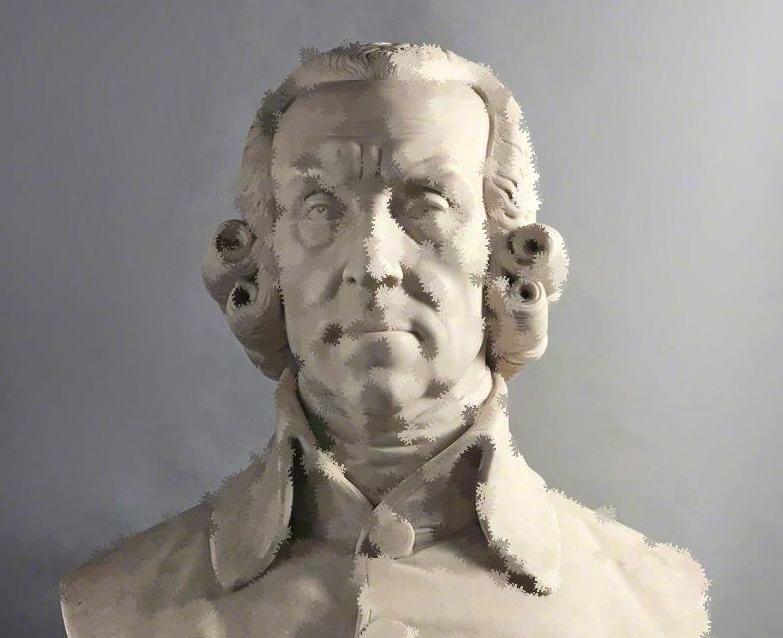
Inequality, Domination and Moral Disciplining
On Adam Smith’s politics for commercial societies
Mateus Martins Bruno

Slide 2
Some Starting Questions
Inequality
Political Factionalism
Religious Sectarianism
How does Smith link these issues?
How Smith’s proposals affect them?
Towards a Politics of Sympathy?
A naturalist paradigm
The ‘vicious’ distant self
On the principles of ‘natural liberty’
On Smith’s empirical assumptions

Slide 3
Naturalism and Moral Theory
In every part of the universe we observe means adjusted with the nicest artifice to the ends which they are intended to produce; and in the mechanism of a plant, or animal body, admire how everything is contrived for advancing the two great purposes of nature, the support of the individual, and the propagation of the species.
(TMS, II.ii.3.5)

Slide 4
Naturalism and Moral Theory
But upon the tolerable observance of these duties [the “general rules of morality”], depends the very existence of human society, which would crumble into nothing if mankind were not generally impressed with a reverence for those important rules of conduct. … those important rules of morality are the commands and laws of the Deity.
(TMS, III.5.2-3)

Slide 5
‘Natural’ Moral Disciplining: how to regulate the “inequalities of our passions”
1. How to acquire the virtues of self-care?
1.1 By facing the unavoidable “hardships, dangers, injuries and misfortunes” (TMS, III.3.36) of a life not entirely shielded against “adversities” (TMS, III.3.25)
1.2 By coexisting “with strangers … who know nothing, or care nothing about your misfortune”, who “are independent of you, who can value you only for your character and conduct, and not for your fortune” (TMS, III.3.36-40)
OBS: The virtues related to self-care arise, counterintuitively, as a correction to the “excessive self-admiration” - to attend our own interests, we must acquire an “other-directed view” (Fleischacker 1999, 155)

Slide 6
Examples of those raised too far above or sunk too far below the “standard of human nature”
1. Those whose upbringing was ‘shielded’ by wealth or power:
They are ‘naturally proud, unfeeling, luxurious, vain, selfish and rapacious’ (TMS, IV.1.10, a compilation of adjectives); their upbringing teaches “flattery and falsehood” (TMS, I.iii.3.2-6); they become “the most frivolous and superficial of mankind” for delighting in “unmerited praise” (TMS, III.2.11); their “vanity” has “no bounds” (WN, III.iv.16); they struggle with any “continual and long exertion of patience, industry, fortitude, and application of thought” (TMS, I.iii.2.5) and with the “adherence to rules” (TMS, V.2.3); they are prone to “profusion” and “profligacy” (WN, II.iii.22; 38-39), they are “prodigal”, “idle”, often living in “festivity and dissipation”, spending money in “baubles,” “ingenious trinkets” and “fineries” (WN, II.iii.38; WN, V.i.g.42); they lose aesthetic sense of “beauty” and the rational sense of “utility”, judging the “merit of an object” by its addition to the “parade of riches” [“scarcity” x desirability] (WN, I.xi.a.31; EPS, IA.I.13); “born of easy fortunes”, they are often unsuccessful in their “professions”, “studies” and “businesses” (WN, V.i.f.4; 36), while “injudicious” and “imprudent” in their investments, due to a lack of “foresight”, potentially hurting others’ “industry” by their “unsuccessful projects” (WN, I.x.b.39; II.iii.19-26; V.i.e.40)

Slide 7
Examples of those raised too far above or sunk too far below the “standard of human nature”
2. Those whose upbringing was sunk in extreme poverty and neglect:
They become “habituated to the idea of [their] own meanness, so sunk in slothful and sottish indifference, as entirely to have forgot the desire, and almost the very wish, for superiority” (TMS, I.iii.2.8); they are rendered “helpless”, “depraved both in mind and body” and “unable to support themselves” (LJA, vi.4-8); they portray a “hatred of labour” and commonly overestimate their chances of succeeding in illegal manners (WN, V.i.b.2); they are more prone to keep on a “bad conduct” even if it harmed the “scant subsistence” of those who depend on them, like wife and children (WN, V.ii.k.7); they become more prone to “riots and debauchery” (LJB, 330); they are more subject to political and religious fanaticism (TMS, VI.ii.2.3; WN, V.i.g.12); they more often seek the “dissipation” of alcohol and gambling (WN, I.viii.44); they are “exceedingly stupid”, they are “cowards … incapable of defending or of revenging” themselves, they can’t “take part in rational conversations”, they can’t “conceive generous, noble or tender sentiments”, and they can’t form “just judgements” (WN, V.i.f.50-60)

Slide 8
‘Natural’ Moral Disciplining: how to regulate the “inequalities of our passions”
2. How to acquire altruistic virtues?
2.1 By proportionately increasing the attention to the needs of others alongside the “gradual increase of ease and enjoyment from having felt before the hardship” (TMS, VI.i.12), after receiving the “real and effectual discipline” that arises from “the fear of losing … employment” (WN, I.x.c.31), for those who live “at ease” can “best attend to the distress of others” (TMS, III.3.37)
2.2 By receiving from our community the security, the guarantee of fairness, equity and isonomy in our institutions, the appropriate education, the public goods (which may encompass even public entertainment and uncensored critique), the appreciation for our carefully considered political opinion and the modes of employment and labour conditions that might incline us to worry less about ourselves, to develop better judgement in general, and to care for others.

Slide 9
Examples of those raised too far above or sunk too far below the “standard of human nature”
1. Those whose upbringing was ‘shielded’ by wealth or power:
They struggle to see “their inferiors as their fellow-creatures”, from the same “species” (LJA, iii.111; TMS, I.iii.2.5; WN, III.iii.8); they often use politics to “deceive and impose upon the Public” policies that are no more than “pieces of dupery” (CAS, Letters 233 & 248); with power, they frequently mistake “arrogance” for “public spirit” treating their ‘inferiors’ as “materials of a … political mechanics” (ALW, IV.25); they are more prone to commit huge injustices associated both to the pursuit of greatness in the name of their country’s supposed interest (WN, IV.viii.17-20; TMS, I.iii.2.2; VI.iii.30-32) or on behalf of their own (WN, IV, vii.a.6-19; IV.vii.c.106; V.i.d.8-12; V.i.e.22; V.i.g.1; V.ii.k.73); by hardly being “censored or reproached” (WN, V.i.g.12) their “faculty of speech” suffers affectations (TMS, VII.iv.24), not learning how to “persuade” others, but only how to “express orders” and “use” people “in a haughty way,” to “domineer” them, nurturing a “love of domination and authority” (LJA, iii.114; WN, III.ii.9-10); as employers, they seldom “listen to the dictates of reason and humanity” (WN, I.viii.44); in general, their “avarice and ambition” was the “universal” cause of most of history’s greatest “tumult and bustle, … rapine and injustice” (WN, V.i.b.2)

Slide 10
Examples of those raised too far above or sunk too far below the “standard of human nature”
2. Those whose upbringing was sunk in extreme poverty and neglect:
They have less self-command over their feelings of “envy” and are “prompted” by “want” to commit crimes (WN, V.i.b.2.); if they manage to work in “great manufactories”, they “frequently ruin” each others’ “morals” and are but “bad company” to one another (WN, I.viii.47-8); they are more prone to accept injustices done to them and to others (WN, I.viii.13) because the greater the “severity” of one’s “misery”, the less one “attends” to the misery of others (TMS, V.2.9); they don’t feel sympathy for others (LJA, ii.179), being both indifferent for their country’s wellbeing and unable to promote either the “public” or their own “private interest” (WN, V.i.f.60)

Slide 11
The “Bulk of the People” Live Under a “Considerable Degree of Virtue”
Crucially, however, because the rich and ambitious are the ones who most extensively labour under the deception that securing the means of utility will make them happy, it is in many ways those without riches and power who have the last laugh.
- Sagar 2022, 180

Slide 12
The ‘Distant Self’: the ills of either receiving too much attention or passing by unnoticed
From what was discussed, one can infer that what unites inequality, factionalism and sectarianism coherently in Smith’s thought is social distance; that is, how separated one from the encounters with fellow-citizens that moralize their sociability, meetings characterized by a fundamental equality between their participants and the a priori possibility of disagreement
The more distant from others, either vertically or horizontally, the less opportunity to interact with those who may disagree or censor our opinions or conduct; the less opportunity for ‘bargaining,’ for self-command, or for compassion, the less sympathy for the distant others and the more distorted is the impartial spectator we form in our minds from actual impartiality; thus, the less chance for developing a “well-formed” mind and heart (TMS, III.2.7), and, therefore, virtuousness (or in Smith’s words, to “improve the understanding, or mend the heart” (WN, V.i.f.32))

Slide 13
A Politics of Sympathy (I)
From this, one may conclude that if a policy increases virtues, and discourages vices, then somehow it affects the formation of the impartial spectator, implying that, coeteris paribus, greater opportunities for sympathy were created, and thus, somehow, relative social distances were diminished by it, either raising people from below, or lowering those from upper stations, or by breaking tribalist barriers between people, all of which seemed to be harming people’s capacity to recognize one another as equals in some fundamental moral sense, and thus becoming able to sympathize with them

Slide 14
A Politics of Sympathy (II)
Thus, if Smith’s proposals, somehow, were expected, according to his principles, to ‘promote virtues’, as is commonly cited in the scholarship, it is because they afford greater opportunities for moral disciplining
An analysis of Smith’s policy proposals and reform outlines reveals an attention to the incentives behind moral education (even economic growth can only be expected as the “natural” outcome of certain virtues being unleashed by favourable circumstances)
Smith’s judgement is that whenever ‘spontaneous’ contexts do not afford encouragement for “humbling the arrogance of [people’s] self-love” (TMS, II.ii.2.1), then it is part of the duty of the state to intervene, not only for the sake of the maintenance of order (WN, V.i.f.60), but also to “discourage every sort of vice” (TMS, II.ii.1.8)

Slide 15
A Politics of Sympathy (III)
Either in the case of Britain’s education, which hopes to raise the workers “self-esteem”* or the abundant interventions hoping to diminish the “arrogance” of those holding the greatest power in their economic and political bargains portrayed in his discussions on taxes, the SNL always indicates the route of forbiddances which redirect people’s choices without positively compelling them (if taxes are, by nature, necessarily a positive mode of obligation, an imposition demanding an action, Smith also attempts to make the most out of them not only in terms of economic efficiency, but in moral efficiency, considering their outcomes over people’s conduct and relationships).
* Better negotiations, greater autonomy and creativity at the workplace (Bruno, 2024), as workers “feel themselves, each individually, more respectable, and more likely to obtain the respect of their lawful superiors” (WN, V.i.f.61). Here the philosopher is also reminding his readers of his earlier definition of good citizenry, “an earnest desire to render the condition of our fellow-citizens as safe, respectable, and happy” as possible (TMS, VI.ii.2.11).

Slide 16
A Politics of Sympathy (Final)
The commonly accepted interpretation that the ‘system’ of natural liberty is, in any sense, absolutely negative does not hold. The example of Smith’s proposals on limiting the absolute liberty within the banking system to avoid the catastrophic outcomes of imprudent choices already reveals it to be a possibility; many of his proposals depend on allowing people to become capable to ensure the conditions through which they could flourish. Smith’s politics is fundamentally about diminishing the cleavages between people without seeking ubiquitous concord, for vertical and horizontal distances feed one another (ex: a poorly educated person is easier to be dominated and to become “dependent” while also being easier to be manipulated). It is, thus, a politics of meaningful discord among equals that opens the possibility of equanimous resolutions
The Politics of Sympathy provides the standard to judge whether or not Smith’s own policy proposals, coherent with the principles provided by the ‘System of Natural Liberty’, would be sufficient to attain their own goals (): that is, whether challenging the empirical assumptions he makes would allow a place for higher demands of intervention coherent with a Smithian framework than generally acknowledged

Slide 17
Examples of Empirical Assumptions
Ex.1: Smith expected that a generalized formal education of certain very basic subjects would increase the labourer’s freedom and creativity within the workplace, tackling the epidemics of ‘stupidity’ that he felt to be as dangerous as the spread of diseases such as lepra (WN, V.i.f.55)
Ex.2: Smith expected that, provided his “Oceana” was indeed implemented, inequality would difficultly translate itself from economic power of purchase into political/personal power over others. He expected accumulated wealth to be dissipated continuously (land being divided by descendants or mismanaged (WN, IV.vii.b.16-20), great companies of international trade being more at the mercy of the imprudence of hired/elected administrators due to their use of money who was not their own, becoming, in time, less efficient in attending demands abroad than “private adventurers” (WN, V.i.e.18) just like the poor colleges of Glasgow and Edinburgh were surpassing the great universities of Oxford and Cambridge due to their greater adaptability to “considerable change” in student’s needs (WN, V.i.f.34)

