Slide 1
Adam Smith and Geneva: Some Long-Lasting Encounters
Alain Alcouffe
F. E. Guerra-Pujol

Slide 2
Prologue
Walter Bagehot (1876) : “Of Adam Smith’s Poli-tical Economy almost an infinite quantity has been said, but very little has been said as to Adam Smith himself. And yet not only was he one of the most curious of human beings, but his books can hardly be understood without having some notion of what manner of man he was.”
W. R. Scott (1940) : “… there remain opportuni-ties, even at this late date, for remedying the present meagre knowledge of Adam Smith’s life.”

Slide 3
Motivation

Slide 4
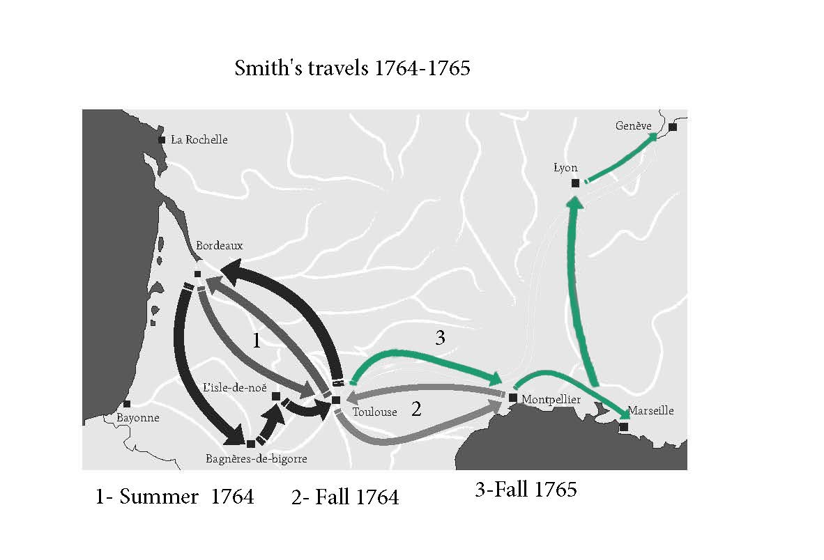

Slide 5
Geneva in 1765/66: Context, Contacts, and Consequences
Many English and French elites are residing in or near Geneva at this moment in time, including the duchesse d’Enville, Charles Bonnet, Lord Stanhope, and Voltaire (Ferney)
Major controversy over Rousseau’s Du contrat social, Emile, and Lettres de la montagne
Exile in Môtiers, renunciation of Genevan citizenship, and eventual flight to England with Hume
Political turmoil
Impasse over the annual election of Geneva’s syndics in January 1766

Slide 6
Some Previous Scholarship on Adam Smith in Geneva
John Rae’s Life of Smith (1895)
Seven encounters : Charles Bonnet, the Syndic Turretin, M. Le Sage, Duc de la Rochefoucauld & Duchess d’Enville, Lord Stanhope, Lady Conyers
Sources : Samuel Rogers, Pierre Prévost, Adam Ferguson, Patrick Clason, letters from and to Smith and Hume
Correspondence of Adam Smith (Glasgow ed., 1977/87)
Brian Bonnyman (2009)
Hints to Lady Stanhope’s table plan for Christmas 1765

Slide 7
Persistent Puzzles
How did Adam Smith’s stay in Geneva influence WN and subsequent editions of TMS?
Many references to Switzerland in WN
Smith retracts his condemnation of La Rochefoucauld’s Maximes in the 6th and final edition of TMS
Also, how long did Smith stay in Geneva and what did he do there?
One more puzzle: What was Smith’s relation to the duchesse d’Enville?

Slide 8
Abbé Colbert of Castlehill’s letter to Adam Smith dated 18 Sept. 1766
« Et toi, Adam Smith, Philosophe de Glascow, heros et idole des highbroad Ladys, que fais-tu, mon cher ami? Comment gouvernes-tu La Duchesse d'Anville et Mad. de Boufflers ….? »

Slide 9
The duchesse d’Enville Marie Louise Nicole de La Rochefoucauld (1716-1797)
A scion of François de La Rochefoucauld (1613 –1680) : Les Maximes, (1664-1678: 5 editions) (compared with Mandeville in the TMS
Great-great granddaughter of the author of Les maximes
She presented the Calas’ affair to Voltaire and played a role in the latter’s defense of the Calas family.
An Enlightened aristocrat, widow at 30, she manages the family estates, holds a salon in Paris and receives the literati in Paris and at her castle at Château-Guyon.
The management of her estates was praised by Arthur Young.

Slide 10
The duchesse d’Enville 2
A mother dedicated to her children, searching the best physician for them --> Dr. Théodore Tronchin in Geneva
She entrusts the scientific education of her son to Georges Le Sage.
Several additional sojourns in Geneva, where she and her sister (Duchesse d’Estissac) visit to escape the burdens of French etiquette.
Also, she is a friend of Turgot and played a role in the beginnings of the Physiocracy.
Perhaps she even introduced Smith to Turgot at her salon in Paris in 1766?

Slide 11
Two sister duchesses
La duchesse d’Enville, par Nattier in 1740 (she was 24 years old)
Madame d’Estissac, par Nattier 1742 (she was 24 years old)

Slide 12
Correspondence of duchesse d’Enville
Her correspondence published by Michèle Crogiez (2016).
Her correspondence with Le Sage and Turgot provides evidence that she was not just a mere “muse” or benefactress but took part in her own right in the scientific debates of her time.
Her exchanges with Turgot and Le Sage contain a mix of scientific observations, protestations of scientific modesty, personal/sentimental teasing.
Also, during the Rousseau/Hume quarrel (summer of 1766), she was on the same line as Smith, avoiding pouring oil on the fire

Slide 13
A possible connection between the duchesse and Adam Smith: James Macdonald
James Macdonald - Marcellus of the North - 8th Bart of Sleat was received in France by the duchesse d’Enville, and he also stayed at her house in Geneva in October 1765.
Smith and the Duke traveled from Dover to Paris with James Macdonald and it is quite possible the three Scots were introduced to the Duchesse by Hume.
More generally, she was very “anglophile” : among her other English-speaking contacts, we find Benjamin Franklin, John Adams, and Charles Stanhope.
To date, however, no evidence of contacts between her and Hume.

Slide 14
La Rochefoucaulds in the Correspondence of Adam Smith
Five (or six) occurrences of La Rochefoucauld in Corr
23 March 1769 from Smith to Lord Hailes (hypothetical mention)
3 May 1776 a quotation of Les Maximes (Hume to Smith)
3 March 1778, from the Duc –Ma mère et moi – new edition
6 Aug. 1779, from the Duc – reference to a letter from Smith
16 Nov. 1784 – Smith sent copies to the Duc and his sister. (TMS? Or WN)
1 Nov. 1785 – Confirmation of the changes in the TMS and “May I beg to be remembered in the most respectful manner to the Dutchess D' Anville and to the Dutchess Chabot”.
Nota bene: The actual exchanges between the Dutchess and Smith seem to be always “protected” or “dissimulated” under the exchanges with or from the children.

Slide 15
Philip, 2nd Earl Stanhope, (1714 –1786)
He was a Fellow of the Royal Society from 1735, and had a lifelong interest in mathematics.
Among other things, he was editor of the works of Robert Simson, Adam Smith's professor at Glasgow.
With his wife Grisel (née Hamilton) they had two sons
Philip Stanhope, Viscount Mahon (24 June 1746 – 6 July 1763). An Etonian, his illness led his parents to sojourn in Geneva entrusting his health to Tronchin
Charles Stanhope, 3rd Earl Stanhope (3 August 1753 – 15 December 1816)
For his part, Smith would later play a role in the appointment of Adam Ferguson as a tutor to the Earl of Chester (to whom Lord Stanhope was guardian).

Slide 16
Lady “Grisel” Stanhope’ Christmas Party 1765

Slide 17
List of the guests
4 Conyers
1 Bucc [leuch]
1 Bucc [leuch]
1 Smith
1 Ditzil
1 Crofts
1 Needham
1 Abingdon
3 Gaussen

Slide 18
Another Geneva connection: John Tuberville Needham (1713-1781)
He was an English biologist and Roman Catholic priest.
Experiment seeming to show that there was a life force that produced spontaneous generation.
Popular with d’Holbach’s materialism
Unpopular with Voltaire’s deism
L'univers m'embarrasse, et je ne puis songer –
Que cette horloge existe et n'ait point d’horloger
Debates with C. Bonnet, Spallazani, and Voltaire!

Slide 19
Yet another Geneva connection: Charles Bonnet (1720-1793)
Letter from Adam Smith to David Hume dated 9 May 1775: “Mr Bonnet, the Gentelman mentioned in the enclosed letter from Mr Clawson, is one of the worthiest, and best hearted men in Geneva or indeed in the world; notwithstanding he is one of the most religious.”

