Slide 1
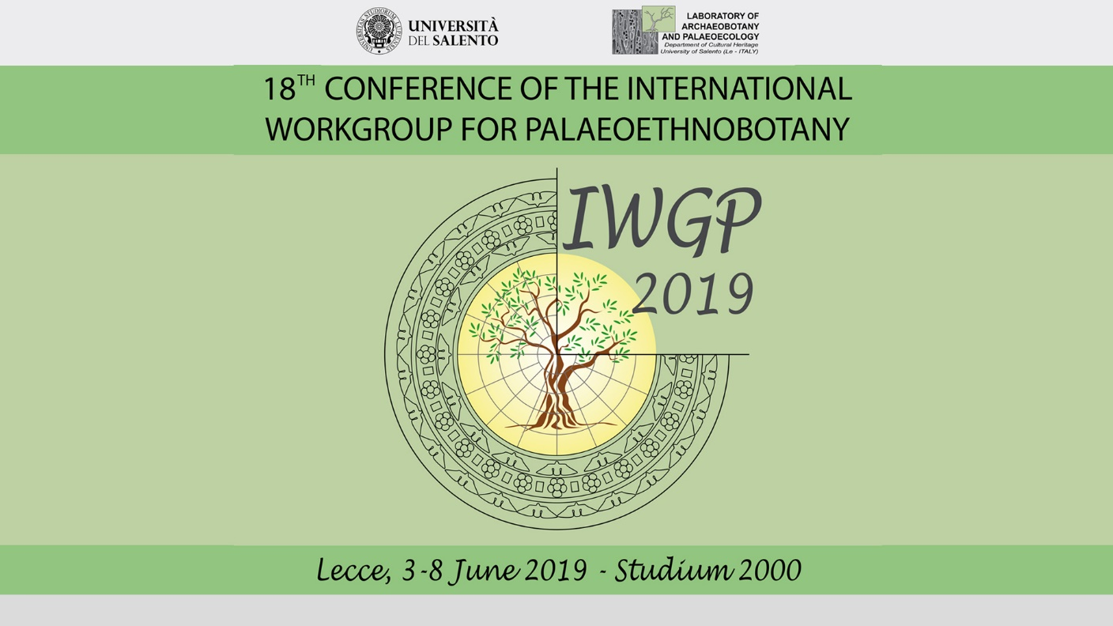
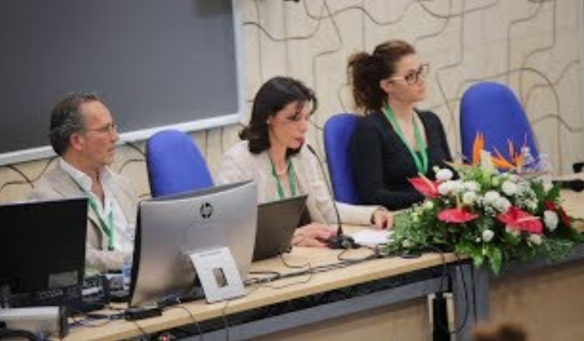

Slide 2
Steering committee
Valentina Caracuta Milena Primavera
Local organizing committee
Aprile Giorgia, Breglia Francesco, Calò Paula, Carmenati Riccardo, Colella Miriana Concetta, D’Aquino Silvia, Della Penna Valeria, Grasso Anna Maria, Minervini Ignazio, Porta Marianna, Sellitto Arianna, Stella Matilde, Stellati Angela, Burhan Ulas
Desk and Room Support
Attanasio Gianluca, Capone Eleonora, Epifani Serena, Godefroy Lou, Grassi Maria, Lengkeek Selma, Mola Rosita, Muscella Silvia

Slide 3
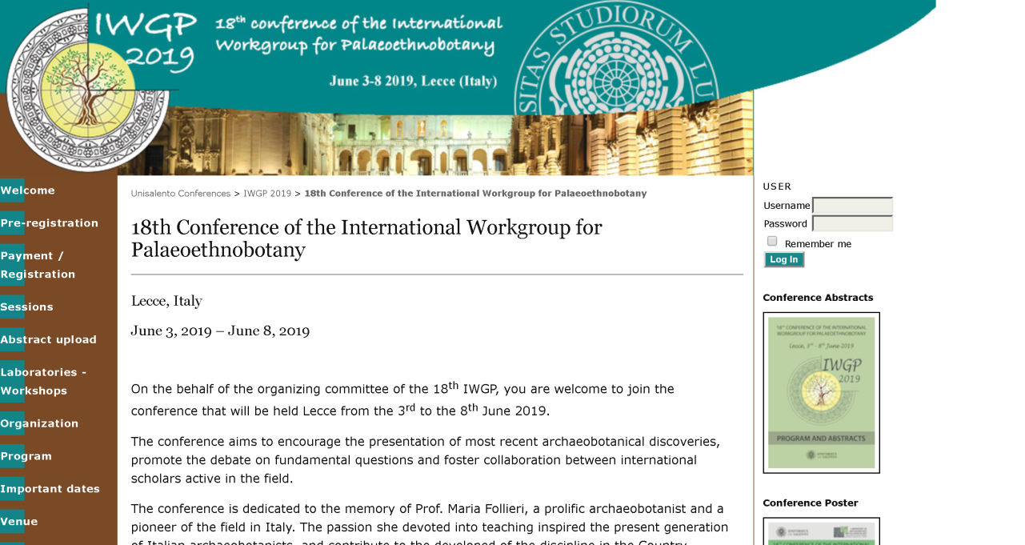
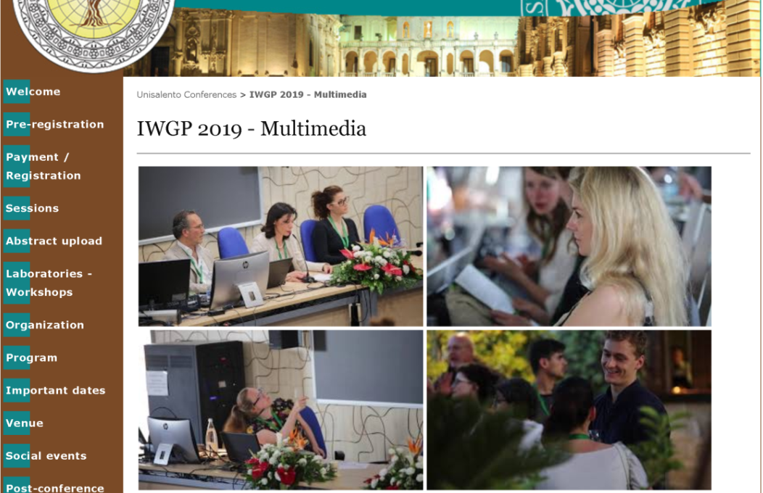
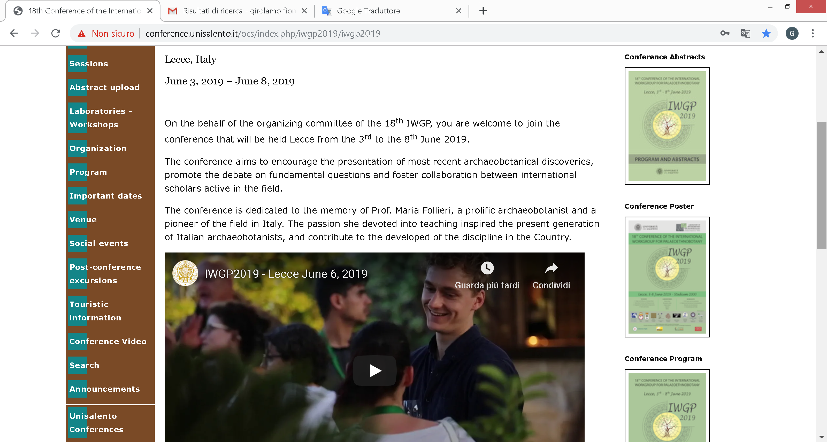
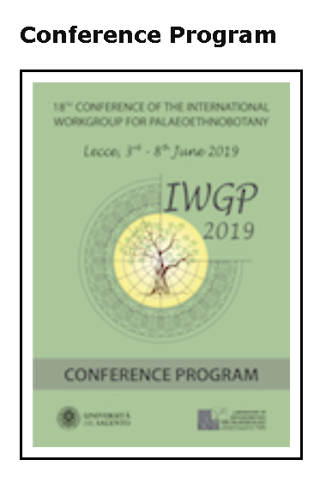
Web Master: Carlo Tafuro
WiFi support: Stefano Pascali
Informatic Support: Donato Bortone
Grafic: Alberto Potenza
Film maker: Emiliano Carico
ESE Salento University Publishing: Rosita Ingrosso
Institutional support - Unisalento
Pro-Rector: D. Fazio,
Delegate for Research: G. Maruccio
Director of Dip. Storia Società e Studi sull’Uomo: F. Pollice
Director of Dip. Beni Culturali: G. Tagliamonte
MUSA: J. D Grossi Mazzorin, G.M. Signore
MUSEO PAPIROLOGICO: P. Davoli
LifeWatch- ERIC Network: A. Basset
Administrative support: Donato De Benedetto, Antonio De Lorenzo, Fabrizio Licchetta, PierLuigi Manti, Guglielmo Corallo

Slide 4
Scientific Board
Girolamo Fiorentino, University of Salento - Italy
Valentina Caracuta, University of Salento - Italy
Milena Primavera, University of Salento - Italy
Anna Maria Mercuri, University of Modena - Italy
Marta Mariotti Lippi, University of Florence - Italy
Mauro Rottoli, University of Trento - Italy
Laura Sadori, University of Rome ‘La Sapienza’ - Italy
Mariano Ucchesu, University of Cagliari - Italy
Andy G. Heiss, Austrian Academy of Science - Austria
VéroniqueZech-Matterne, French Center for Scientific Research (CNRS) - France
Marco Madella, University of Pompeu Fabra – Spain
Leonor Peña-Chocarro, Spanish National Research Council (CSIC) - Spain

Slide 5
Laboratories Organizers
Workshops Organizers
Naked Wheat: Angela Kreuz, Ferran Antolin and Marlu Kühn
Legumes: Valentina Caracuta and Yoel Melamed
New Glume Wheat: Dragana Filipovic, Liz Stroud, Amy Bogaard, Francoise Toulemonde, Sultana Valamoti and Burhan Ulas
Millets: Dorian Fuller and Marco Madella
Image Analysis: Laurent Bouby and Clemence Pagnoux
Special Support: Ilaria Rosati (LifeWatch)
ERC PROJECT AND ARCHAEOBOTANY: Amy Bogaard, Dorian Fuller, Sultana Maria Valamoti, Leonor Pena Chocarro and Carla Lancelotti
ARCHAEOBOTANY AND PUBLIC: Cornelie Moolhuizen, Dragana Filipovic, David Stone
NATIONAL AND INTERNATIONAL ARCHAEOBOTANICAL NETWORKS: NOT ONLY DATABASES: Anna Maria Mercuri , Assunta Florenzano, Wiebke Kirleis, Feix Bittmann, Angela Kreuz, Alexandra Livarda, Lisa Lodwick, Adela Pokorna, Simone Riehl
Special Support: Elena Stanca (LifeWatch)

Slide 6
Chair of sessions
Donatella Magri, Isabella Caneva, Laura Sadori, Felix Bittman, Dorian Fuller, Monica Badura, Elisabetta Boaretto, Marco Madella, Ehud Weiss, Francesco D’Andria, Sultana Valamoti, Amy Bogaard, Naomi Miller, Andy Heiss, Veronique Zech-Matterne, Margareta Tengberg
Special Speakers
Karl Hammer
Chiara Morini

Slide 7
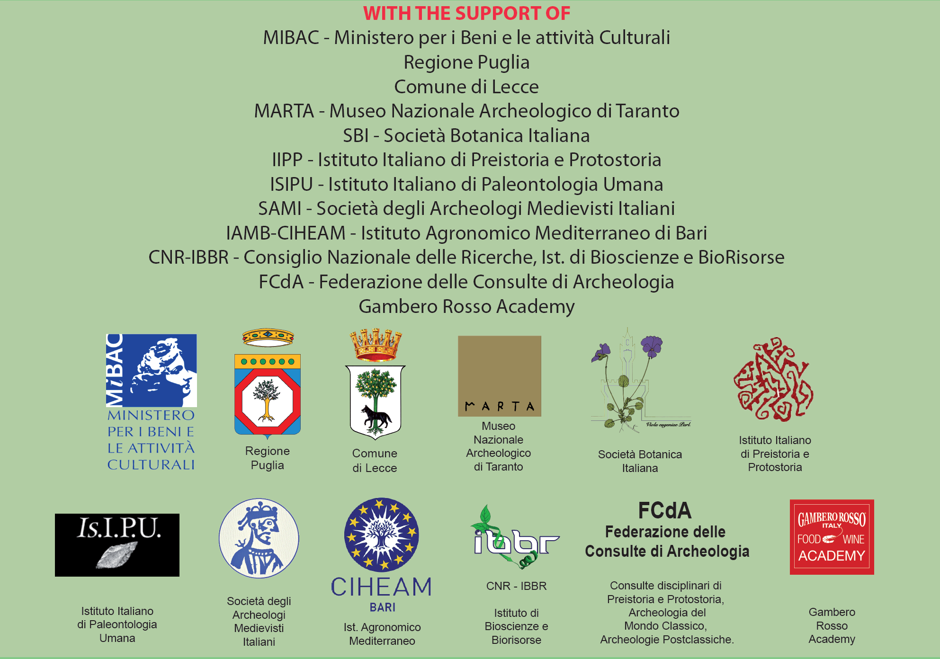

Slide 8
Welcome Cocktail Organizer
GAMBERO ROSSO ACADEMY
Fiorella Perrone
Francesca Pagano
Technical Support
NIKON
Mario Lippolis
Fabrizio Lucci

Slide 9
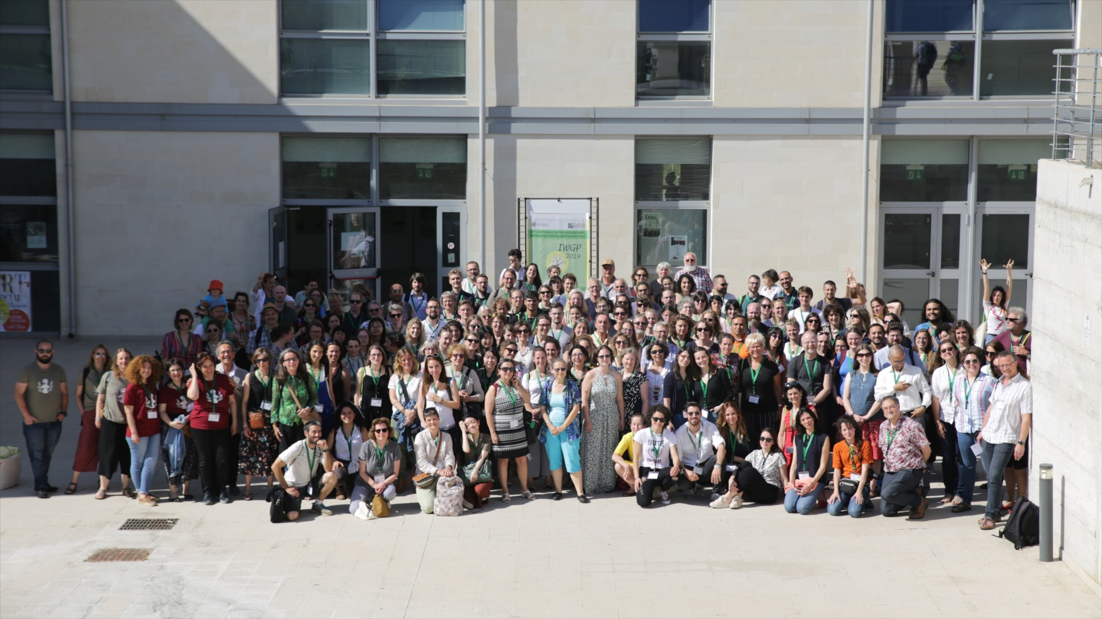
Grazie a tutti
See you at next IWGP……

